Slide 1







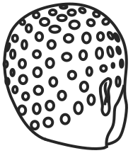

cqEEG & nfbBCI
24/05/2024

Slide 2
rtNFB
software
haptic feedback
cqEEG

Slide 3
software
rtNFB
cqEEG
haptic feedback

Slide 4
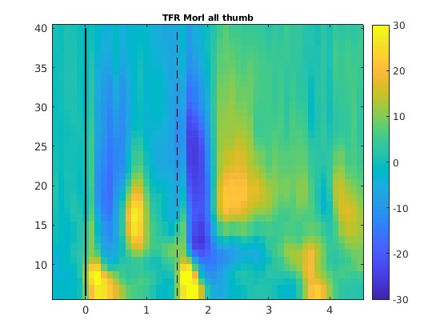
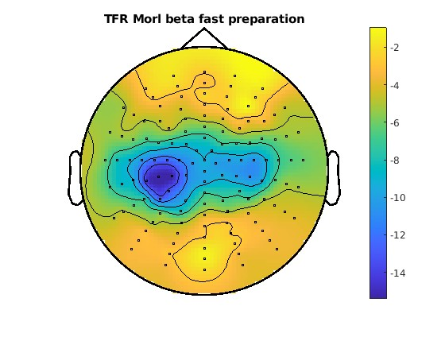
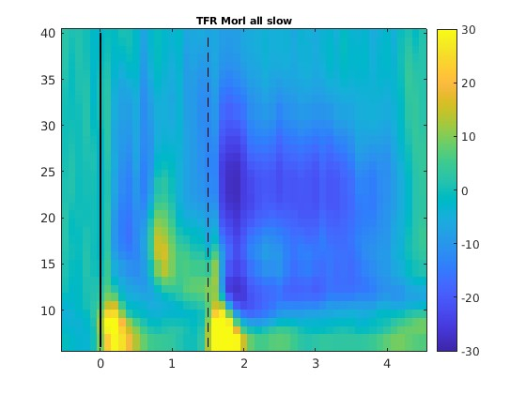
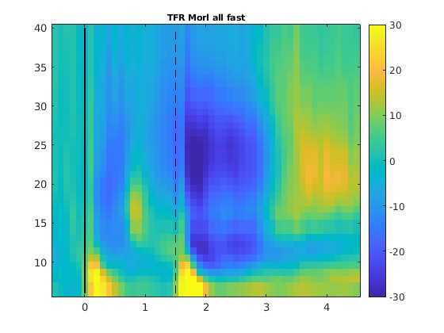


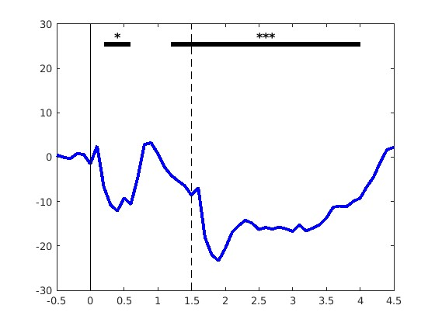
software
rtNFB
cqEEG
haptic feedback
cqEEG
LMM | RT ~ 1 + power + (1|subject)
Pow | all | 30 | 70 | 110 | 150
Mu |  | * |  |  | *
lowB | * |  | **
highB |  |  |  | **
Beta | * |  | **

Slide 5
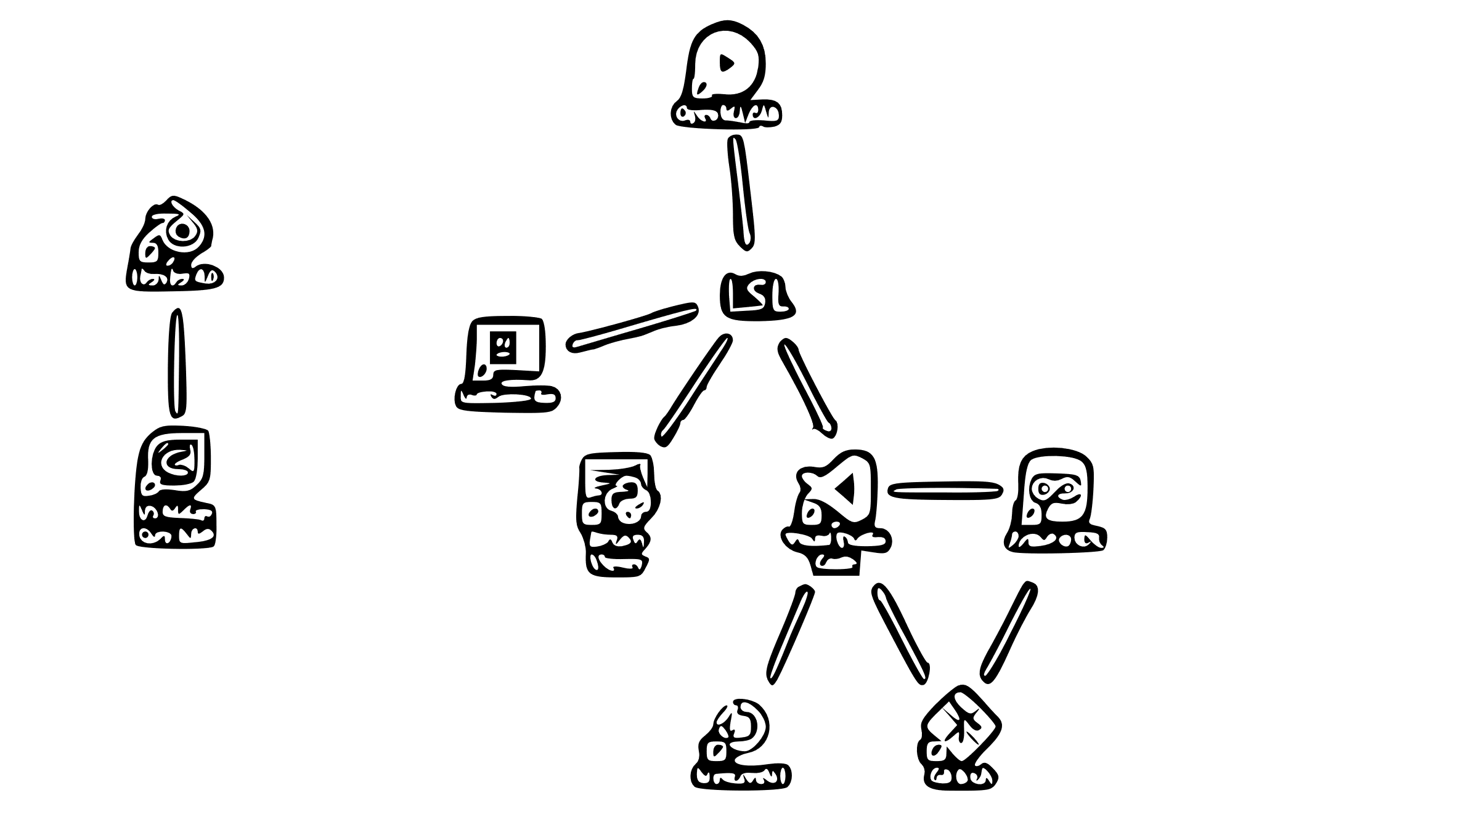
software
rtNFB
cqEEG
haptic feedback
cqEEG
LMM | RT ~ 1 + power + (1|subject)
Pow | all | 30 | 70 | 110 | 150
Mu |  | * |  |  | *
lowB | * |  | **
highB |  |  |  | **
Beta | * |  | **

Slide 6
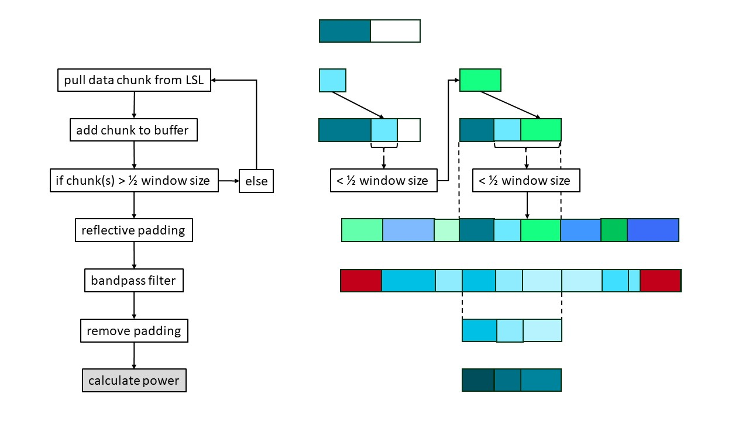
software
rtNFB
cqEEG
haptic feedback
cqEEG
LMM | RT ~ 1 + power + (1|subject)
Pow | all | 30 | 70 | 110 | 150
Mu |  | * |  |  | *
lowB | * |  | **
highB |  |  |  | **
Beta | * |  | **

Slide 7
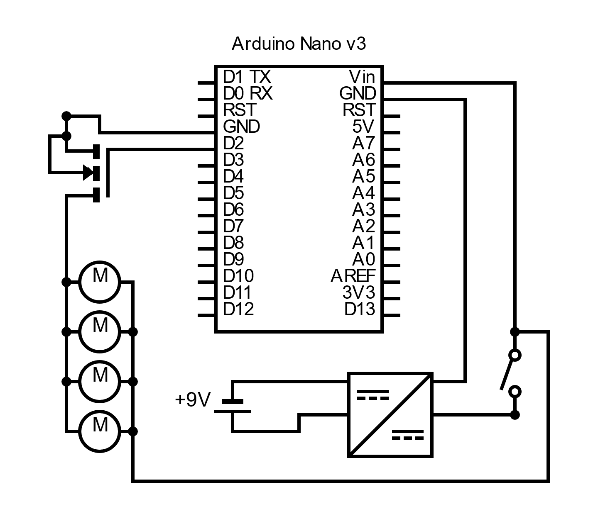
software
rtNFB
rtNFB
cqEEG
haptic feedback
LMM | RT ~ 1 + power + (1|subject)
Pow | all | 30 | 70 | 110 | 150
Mu |  | * |  |  | *
lowB | * |  | **
highB |  |  |  | **
Beta | * |  | **

Slide 8
TFRs
rtNFB
software
Fast
cqEEG
Slow
Thumb
Frequency [Hz]
LMM | RT ~ 1 + power + (1|subject)
Power [ms] | 0 - 1500 | 0 - 300 | 400 -700 | 800 -1100 | 1200 -1500
Mu |  | * [+]
lowBeta |  |  | **[-]
highBeta
Beta |  |  | ** [-]
Time [s]
haptic feedback

Slide 9
TFRs
cqEEG
Slow
Fast
Thumb
Frequency [Hz]
Time [s]

Slide 10
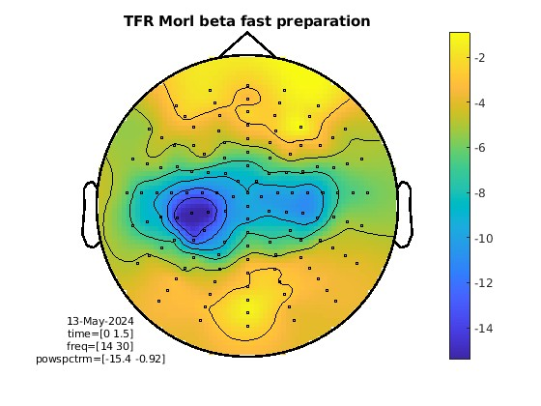
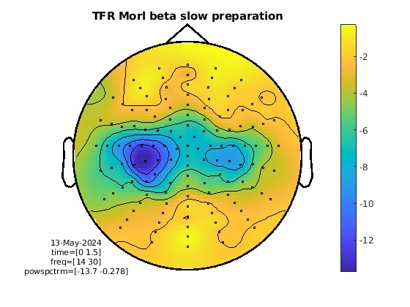
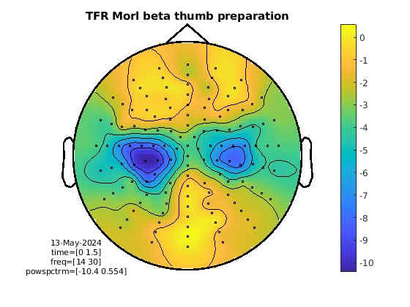
Topoplots beta (14-30 Hz) - preparation period
Slow
Fast
Thumb

Slide 11
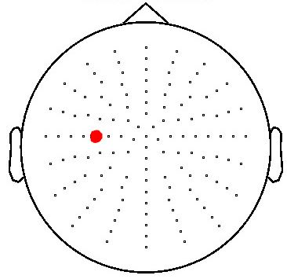
C3
* p < 0.05
** p < 0.01
*** p < 0.001
[+] positive corr.
[-] negative corr.
Linear mixed models (LMMs)
LMM | RT ~ 1 + power + (1|subject)
power [ms] | 0 - 1500 | 0 - 300 | 400 -700 | 800 -1100 | 1200 -1500
mu |  | ** [+]
lowBeta
highBeta
beta
LMM | RT ~ 1 + power + (1|subject)
power [ms] | 0 - 1500 | 0 - 300 | 400 -700 | 800 -1100 | 1200 -1500
mu |  |  |  | * [-]
lowBeta |  |  | **[-] | * [-]
highBeta
beta |  |  |  | * [-]
Predictors of behaviour:
- Which frequency band …
- at what time during preparation …
- predicts RT?

Slide 12
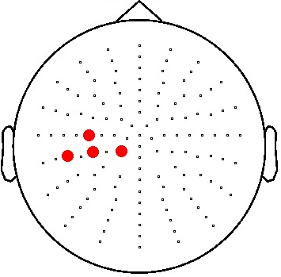
C3
* p < 0.05
** p < 0.01
*** p < 0.001
[+] positive corr.
[-] negative corr.
LMMs
Cluster 4
LMM | RT ~ 1 + power + (1|subject)
power [ms] | 0 - 1500 | 0 - 300 | 400 -700 | 800 -1100 | 1200 -1500
mu |  | ** [+]
lowBeta
highBeta
beta
LMM | RT ~ 1 + power + (1|subject)
power [ms] | 0 - 1500 | 0 - 300 | 400 -700 | 800 -1100 | 1200 -1500
mu |  |  |  | * [-]
lowBeta |  |  | **[-] | * [-]
highBeta
beta |  |  |  | * [-]
LMM | timingPrecision ~ 1 + power + (1|subject)
power [ms] | 0 - 1500 | 0 - 300 | 400 -700 | 800 -1100 | 1200 -1500
mu |  |  |  |  | * [-]
lowBeta | * [-] |  |  | * [-]
highBeta | * [-] |  | * [-] | * [-]
beta | ** [-] |  | * [-] | ** [-]
LMM | timingPrecision ~ 1 + power + (1|subject)
power [ms] | 0 - 1500 | 0 - 300 | 400 -700 | 800 -1100 | 1200 -1500
mu
lowBeta | * [-] |  |  | * [-]
highBeta
beta | *** [-] |  | * [-] | ** [-] | * [-]
Predictors of behaviour:
- Which frequency band …
- at what time during preparation …
- predicts RT?

Slide 13
C3
* p < 0.05
** p < 0.01
*** p < 0.001
[+] positive corr.
[-] negative corr.
LMMs
Cluster 4
LMM | RT ~ 1 + power + (1|subject)
power [ms] | 0 - 1500 | 0 - 300 | 400 -700 | 800 -1100 | 1200 -1500
mu |  | ** [+]
lowBeta
highBeta
beta
LMM | RT ~ 1 + power + (1|subject)
power [ms] | 0 - 1500 | 0 - 300 | 400 -700 | 800 -1100 | 1200 -1500
mu |  |  |  | * [-]
lowBeta |  |  | **[-] | * [-]
highBeta
beta |  |  |  | * [-]
LMM | timingPrecision ~ 1 + power + (1|subject)
power [ms] | 0 - 1500 | 0 - 300 | 400 -700 | 800 -1100 | 1200 -1500
mu |  |  |  |  | * [-]
lowBeta | * [-] |  |  | * [-]
highBeta | * [-] |  | * [-] | * [-]
beta | ** [-] |  | * [-] | ** [-]
LMM | timingPrecision ~ 1 + power + (1|subject)
power [ms] | 0 - 1500 | 0 - 300 | 400 -700 | 800 -1100 | 1200 -1500
mu
lowBeta | * [-] |  |  | * [-]
highBeta
beta | *** [-] |  | * [-] | ** [-] | * [-]

Slide 14
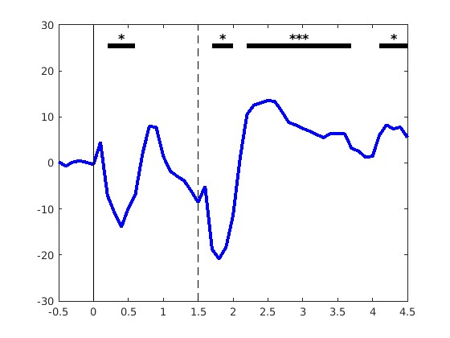
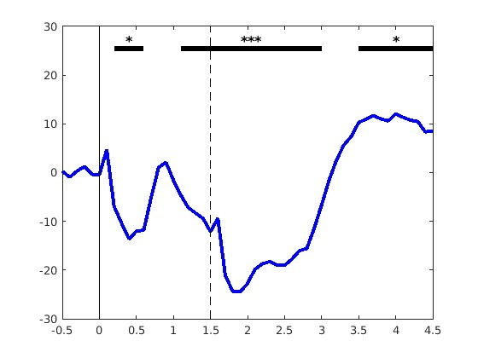
Cluster-based permutation test
Thumb
Slow
Fast
During what times in a trial can we see significant deviations from baseline?
beta
Power [percent change]
Time [s]

Slide 15
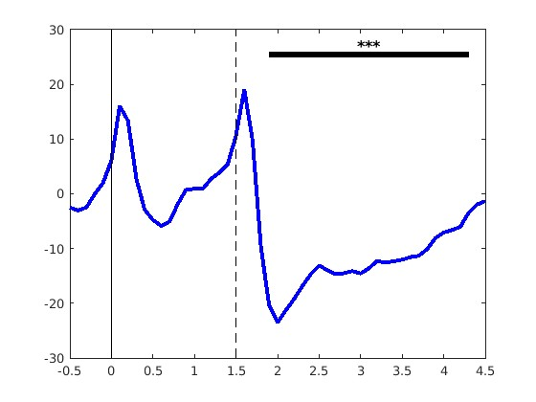
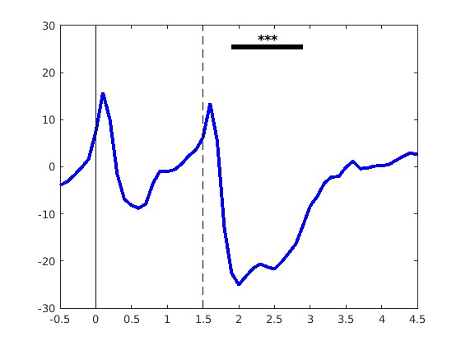
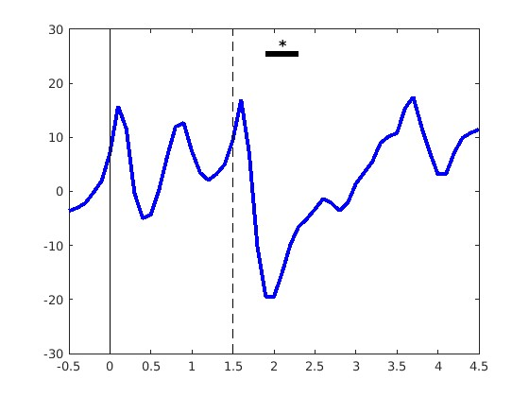
Cluster-based permutation test
Slow
Fast
Thumb
beta
Power [percent change]
Time [s]
mu

Slide 16
Cluster-based permutation test
cqEEG
Slow
Fast
Thumb
LMM | RT ~ 1 + power + (1|subject)
Power [ms] | 0 - 1500 | 0 - 300 | 400 -700 | 800 -1100 | 1200 -1500
Mu |  | * [+]
lowBeta |  |  | **[-]
highBeta
Beta |  |  | ** [-]
beta
Power [percent change]
mu
Time [s]

Slide 17
rtNFB
rtNFB
software
cqEEG
LMM | RT ~ 1 + power + (1|subject)
Power [ms] | 0 - 1500 | 0 - 300 | 400 -700 | 800 -1100 | 1200 -1500
Mu |  | * [+]
lowBeta |  |  | **[-]
highBeta
Beta |  |  | ** [-]
haptic feedback

Slide 18
software
rtNFB
rtNFB
cqEEG
haptic feedback
LMM | RT ~ 1 + power + (1|subject)
Pow | all | 30 | 70 | 110 | 150
Mu |  | * |  |  | *
lowB | * |  | **
highB |  |  |  | **
Beta | * |  | **

Slide 19
software
rtNFB
rtNFB
cqEEG
haptic feedback
LMM | RT ~ 1 + power + (1|subject)
Pow | all | 30 | 70 | 110 | 150
Mu |  | * |  |  | *
lowB | * |  | **
highB |  |  |  | **
Beta | * |  | **

Slide 20
rtNFB
software
cqEEG
haptic feedback
cqEEG
LMM | RT ~ 1 + power + (1|subject)
Pow | all | 30 | 70 | 110 | 150
Mu |  | * |  |  | *
lowB | * |  | **
highB |  |  |  | **
Beta | * |  | **

Slide 22
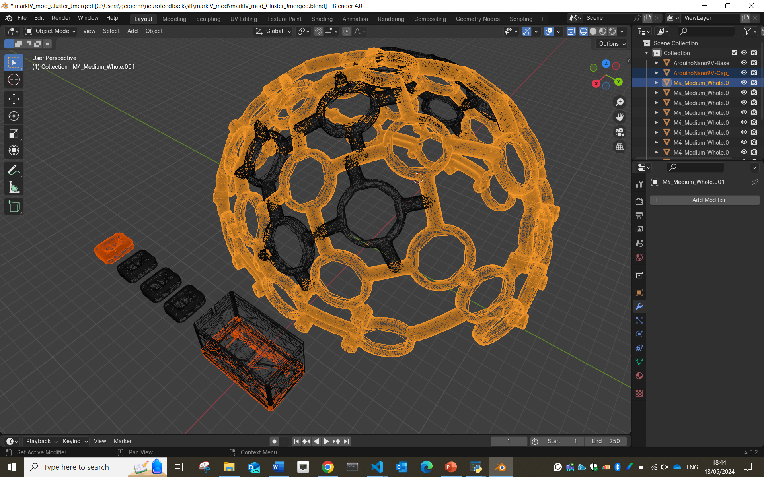
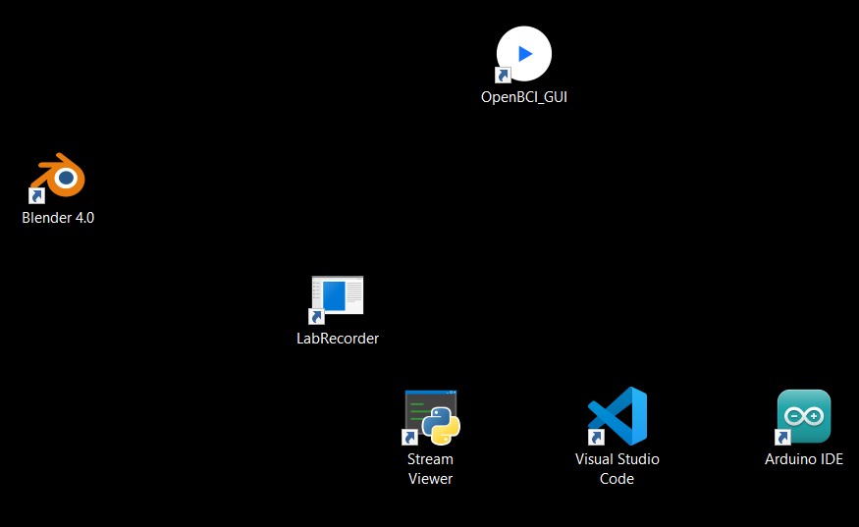
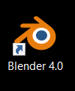

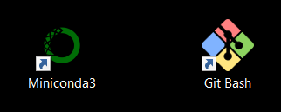
LSL

Slide 23
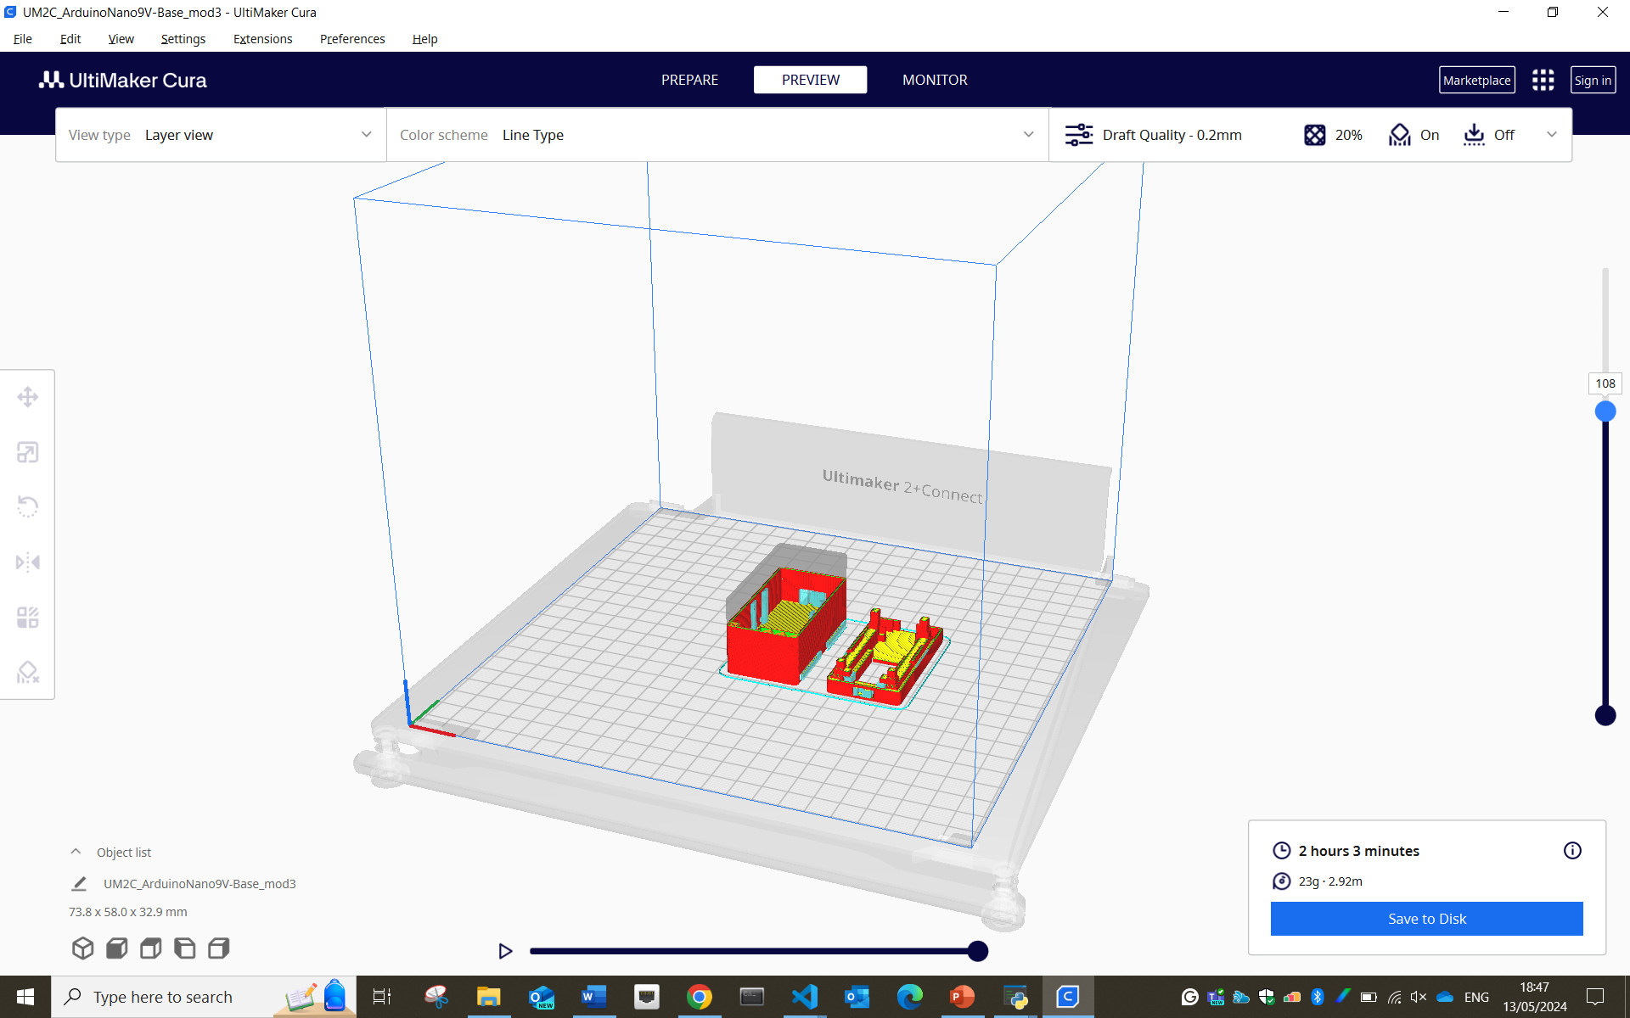
LSL

Slide 24
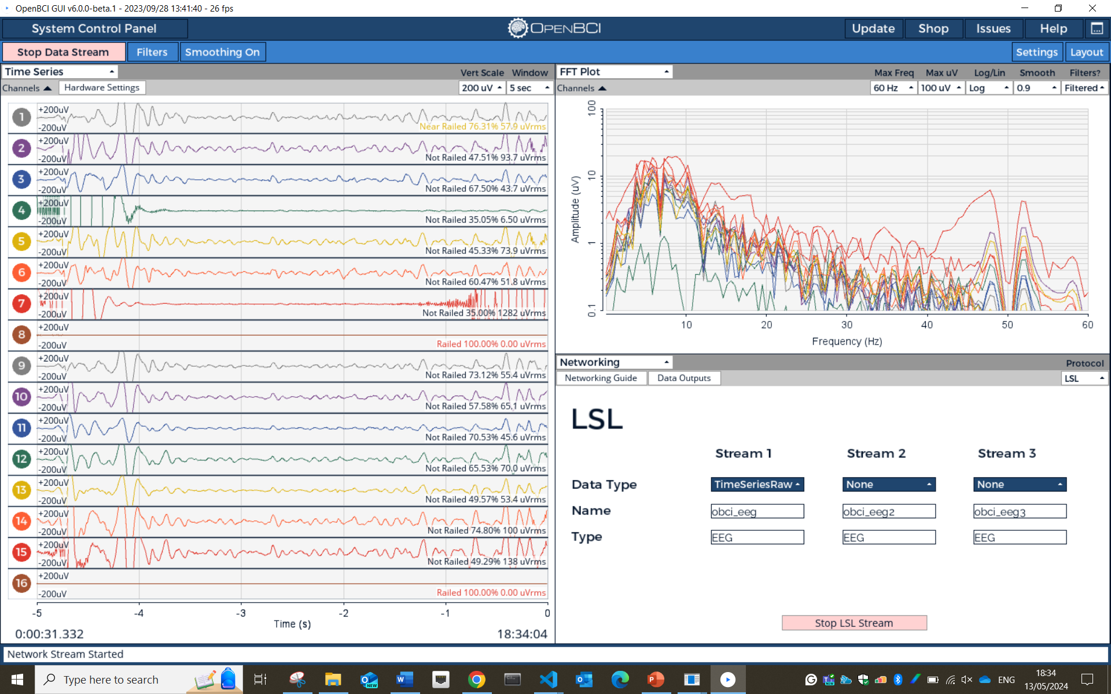
LSL

Slide 25
Lab Streaming Layer
stream, receive, synchronise, and record neural, physiological, and behavioural data streams acquired from diverse sensor hardware with millisecond-precision
LSL

Slide 26
EMG
IMUs
Lab Streaming Layer
stream, receive, synchronise, and record neural, physiological, and behavioural data streams acquired from diverse sensor hardware with millisecond-precision
LSL
…

Slide 27
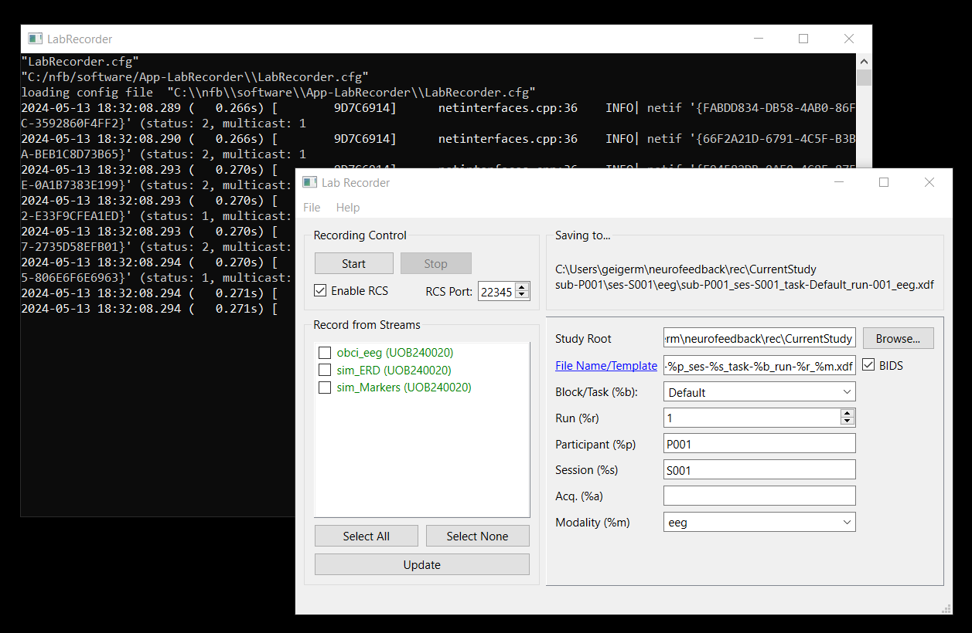
Lab Streaming Layer
stream, receive, synchronise, and record neural, physiological, and behavioural data streams acquired from diverse sensor hardware with millisecond-precision
EMG
LSL
IMUs
…

Slide 28
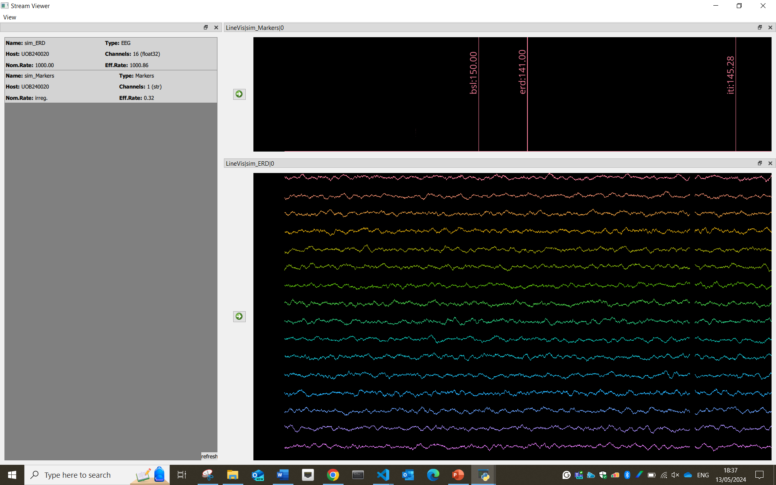
Lab Streaming Layer
stream, receive, synchronise, and record neural, physiological, and behavioural data streams acquired from diverse sensor hardware with millisecond-precision
LSL
EMG
IMUs
…

Slide 29
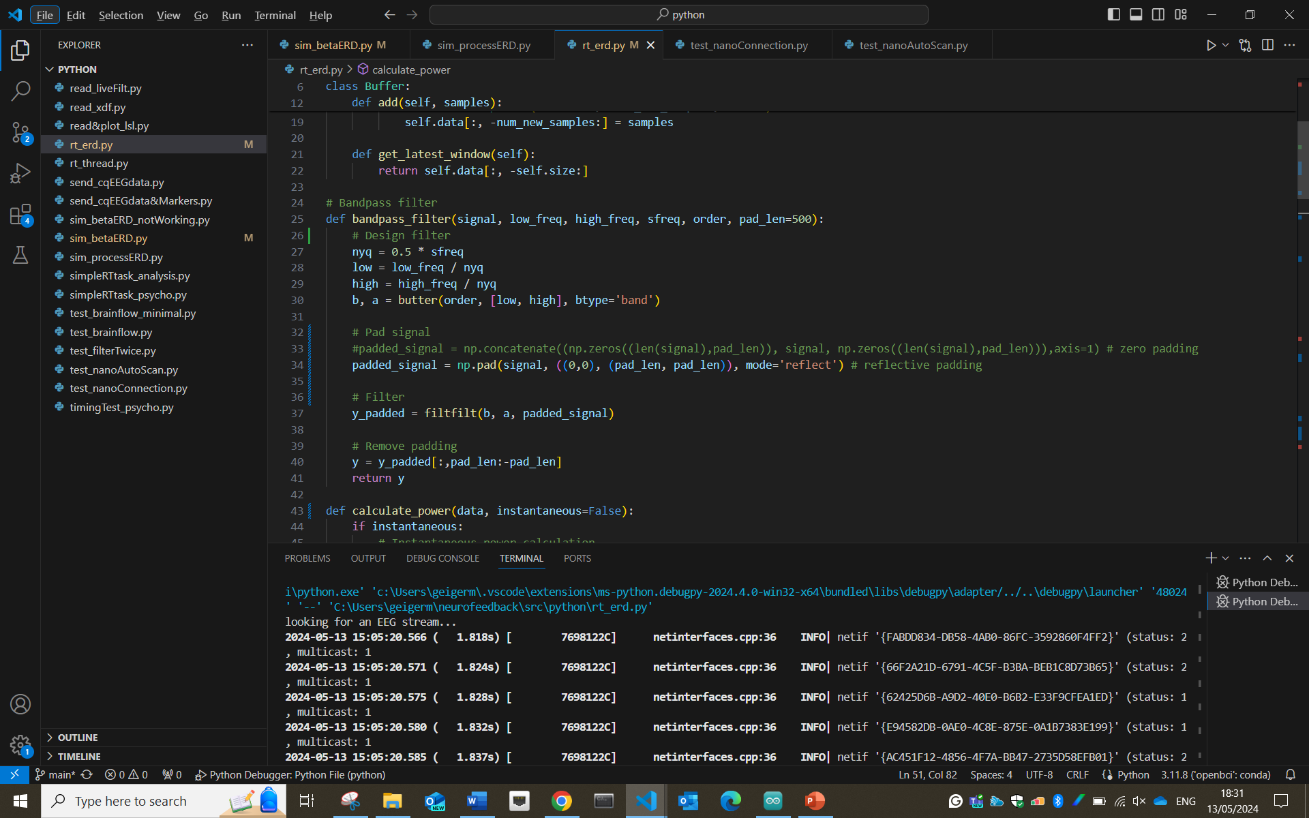
LSL

Slide 30
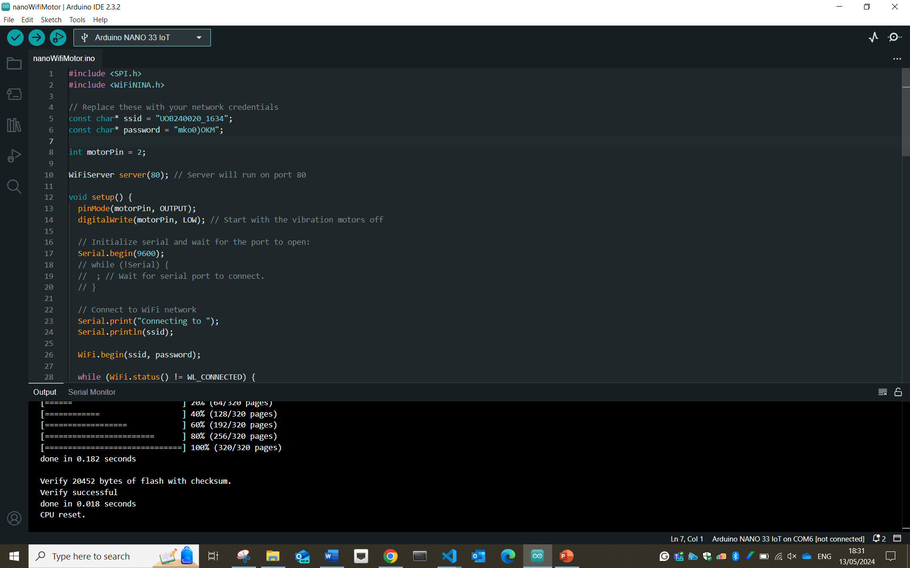
LSL

Slide 31
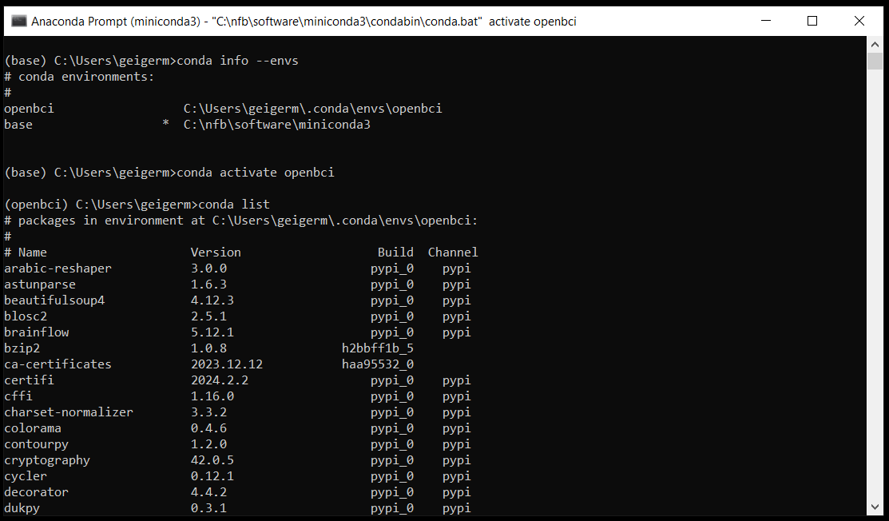
LSL

Slide 32
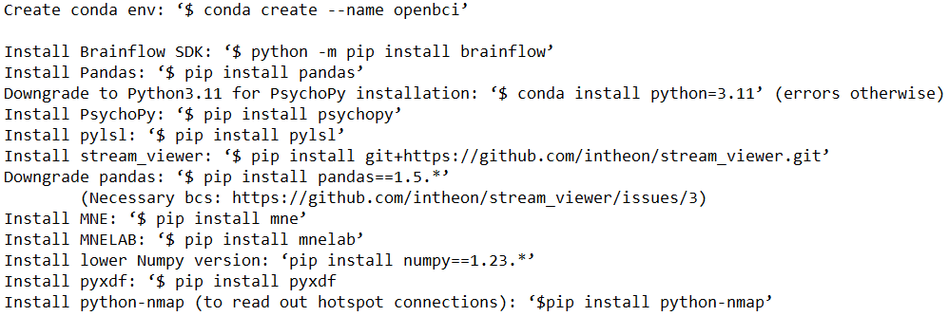
LSL

Slide 33
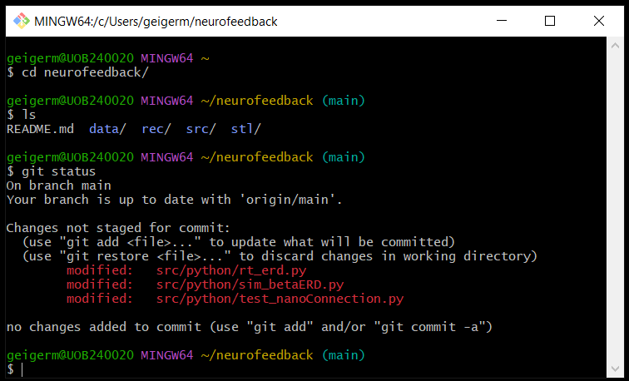
LSL

Slide 34
LSL

Slide 35
LSL

Slide 37
rtNFB
software
cqEEG
haptic feedback
cqEEG
LMM | RT ~ 1 + power + (1|subject)
Pow | all | 30 | 70 | 110 | 150
Mu |  | * |  |  | *
lowB | * |  | **
highB |  |  |  | **
Beta | * |  | **

Slide 38
software
rtNFB
cqEEG
haptic feedback
LMM | RT ~ 1 + power + (1|subject)
Pow | all | 30 | 70 | 110 | 150
Mu |  | * |  |  | *
lowB | * |  | **
highB |  |  |  | **
Beta | * |  | **

Slide 39
software
rtNFB
cqEEG
haptic feedback
LMM | RT ~ 1 + power + (1|subject)
Pow | all | 30 | 70 | 110 | 150
Mu |  | * |  |  | *
lowB | * |  | **
highB |  |  |  | **
Beta | * |  | **

Slide 40
software
rtNFB
cqEEG
haptic feedback
LMM | RT ~ 1 + power + (1|subject)
Pow | all | 30 | 70 | 110 | 150
Mu |  | * |  |  | *
lowB | * |  | **
highB |  |  |  | **
Beta | * |  | **

Slide 41
pull data chunk from LSL
rtNFB

Slide 42
pull data chunk from LSL
add chunk to buffer

Slide 43
pull data chunk from LSL
add chunk to buffer
if chunk(s) ≥ ½ window size
else

Slide 44
250 ms
pull data chunk from LSL
add chunk to buffer
if chunk(s) ≥ ½ window size
else

Slide 45
250 ms
pull data chunk from LSL
add chunk to buffer
if chunk(s) ≥ ½ window size
else

Slide 46
250 ms
pull data chunk from LSL
add chunk to buffer
if chunk(s) ≥ ½ window size
else

Slide 47
250 ms
pull data chunk from LSL
add chunk to buffer
if chunk(s) ≥ ½ window size
else

Slide 48
250 ms
pull data chunk from LSL
add chunk to buffer
if chunk(s) ≥ ½ window size
else

Slide 49
pull data chunk from LSL
add chunk to buffer
if chunk(s) ≥ ½ window size
else

Slide 50
pull data chunk from LSL
add chunk to buffer
if chunk(s) ≥ ½ window size
else

Slide 51
pull data chunk from LSL
add chunk to buffer
if chunk(s) ≥ ½ window size
else
< ½ window size

Slide 52
pull data chunk from LSL
add chunk to buffer
if chunk(s) ≥ ½ window size
else
< ½ window size

Slide 53
pull data chunk from LSL
add chunk to buffer
if chunk(s) ≥ ½ window size
else
< ½ window size

Slide 54
pull data chunk from LSL
add chunk to buffer
if chunk(s) ≥ ½ window size
else
< ½ window size

Slide 55
pull data chunk from LSL
add chunk to buffer
if chunk(s) ≥ ½ window size
else
< ½ window size
> ½ window size

Slide 56
pull data chunk from LSL
add chunk to buffer
if chunk(s) ≥ ½ window size
else
< ½ window size
> ½ window size
reflective padding
bandpass filter

Slide 57
pull data chunk from LSL
add chunk to buffer
if chunk(s) ≥ ½ window size
else
< ½ window size
> ½ window size
reflective padding
bandpass filter

Slide 58
pull data chunk from LSL
add chunk to buffer
if chunk(s) ≥ ½ window size
else
< ½ window size
> ½ window size
reflective padding
bandpass filter
remove padding

Slide 59
250 ms
1
2
3
4
5
pull data chunk from LSL
add chunk to buffer
if chunk(s) ≥ ½ window size
else
< ½ window size
> ½ window size
reflective padding
bandpass filter
remove padding
calculate power

Slide 60
250 ms
1
2
3
4
5
pull data chunk from LSL
add chunk to buffer
if chunk(s) ≥ ½ window size
else
< ½ window size
> ½ window size
reflective padding
bandpass filter
remove padding
calculate median power

Slide 61
pull data chunk from LSL
250 ms
add chunk to buffer
1
if chunk(s) ≥ ½ window size
else
2
3
4
5
reflective padding
bandpass filter
remove padding
calculate median power
thresholding
threshold
< ½ window size
> ½ window size

Slide 62
30 s
pull data chunk from LSL
250 ms
add chunk to buffer
1
if chunk(s) ≥ ½ window size
else
2
3
4
…
5
reflective padding
bandpass filter
239
remove padding
calculate median power
thresholding
threshold

Slide 63
30 s
pull data chunk from LSL
250 ms
add chunk to buffer
1
if chunk(s) ≥ ½ window size
else
2
3
4
…
reflective padding
5
bandpass filter
239
remove padding
calculate median power
median power
thresholding
threshold

Slide 64
30 s
250 ms
250 ms
pull data chunk from LSL
add chunk to buffer
if chunk(s) ≥ ½ window size
else
…
reflective padding
1
2
3
4
5
239
bandpass filter
remove padding
calculate median power
median power
thresholding
threshold

Slide 65
pull data chunk from LSL
add chunk to buffer
if chunk(s) ≥ ½ window size
else
…
reflective padding
1
2
3
4
5
239
bandpass filter
remove padding
n
calculate median power
median power
thresholding
threshold
beta power

Slide 66
pull data chunk from LSL
add chunk to buffer
if chunk(s) ≥ ½ window size
else
…
reflective padding
1
2
3
4
5
239
bandpass filter
25th percentile
remove padding
n
calculate median power
median power
thresholding
threshold
beta power

Slide 67
pull data chunk from LSL
add chunk to buffer
if chunk(s) ≥ ½ window size
else
reflective padding
bandpass filter
remove padding
calculate median power
1
2
3
4
5
239
thresholding
25th percentile
n
median power
beta power
threshold

Slide 68
pull data chunk from LSL
add chunk to buffer
if chunk(s) ≥ ½ window size
else
reflective padding
bandpass filter
remove padding
calculate median power
thresholding
feedback

Slide 69
software
pull data chunk from LSL
add chunk to buffer
if chunk(s) ≥ ½ window size
else
reflective padding
bandpass filter
remove padding
calculate power
thresholding
feedback
rtNFB
cqEEG
haptic feedback
LMM | RT ~ 1 + power + (1|subject)
Pow | all | 30 | 70 | 110 | 150
Mu |  | * |  |  | *
lowB | * |  | **
highB |  |  |  | **
Beta | * |  | **

Slide 70
software
rtNFB
rtNFB
cqEEG
haptic feedback
LMM | RT ~ 1 + power + (1|subject)
Pow | all | 30 | 70 | 110 | 150
Mu |  | * |  |  | *
lowB | * |  | **
highB |  |  |  | **
Beta | * |  | **

Slide 71
software
rtNFB
rtNFB
cqEEG
haptic feedback
LMM | RT ~ 1 + power + (1|subject)
Pow | all | 30 | 70 | 110 | 150
Mu |  | * |  |  | *
lowB | * |  | **
highB |  |  |  | **
Beta | * |  | **

Slide 72
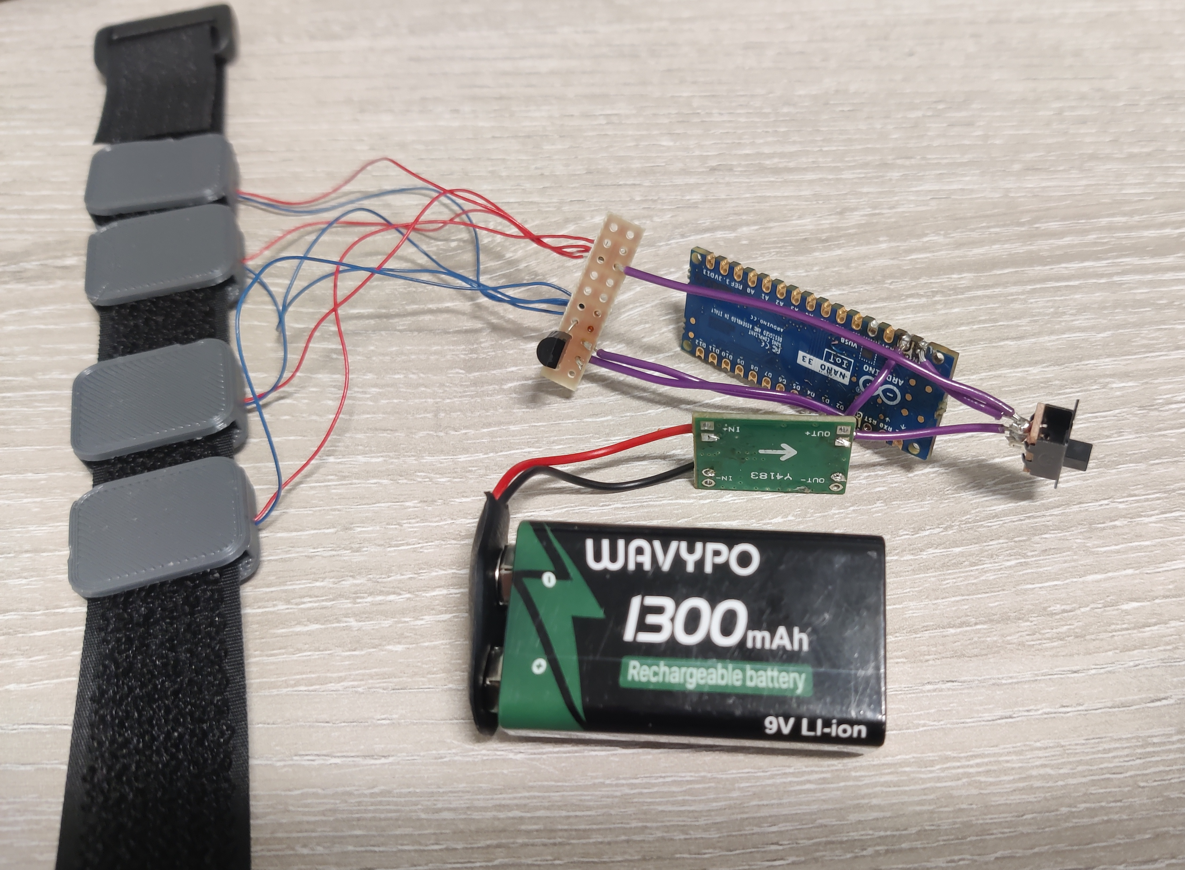
software
rtNFB
haptic feedback
cqEEG
cqEEG
LMM | RT ~ 1 + power + (1|subject)
Pow | all | 30 | 70 | 110 | 150
Mu |  | * |  |  | *
lowB | * |  | **
highB |  |  |  | **
Beta | * |  | **

Slide 73
haptic feedback

Slide 74
haptic feedback

Slide 75
haptic feedback

Slide 76
haptic feedback

Slide 77
haptic feedback

Slide 78
haptic feedback

Slide 79
software
rtNFB
rtNFB
haptic feedback
cqEEG
cqEEG
LMM | RT ~ 1 + power + (1|subject)
Pow | all | 30 | 70 | 110 | 150
Mu |  | * |  |  | *
lowB | * |  | **
highB |  |  |  | **
Beta | * |  | **

Slide 80
software
rtNFB
rtNFB
cqEEG
haptic feedback
LMM | RT ~ 1 + power + (1|subject)
Pow | all | 30 | 70 | 110 | 150
Mu |  | * |  |  | *
lowB | * |  | **
highB |  |  |  | **
Beta | * |  | **

Slide 81
software
rtNFB
rtNFB
cqEEG
haptic feedback
LMM | RT ~ 1 + power + (1|subject)
Pow | all | 30 | 70 | 110 | 150
Mu |  | * |  |  | *
lowB | * |  | **
highB |  |  |  | **
Beta | * |  | **

Slide 82
Thank you!
software
rtNFB
rtNFB
haptic feedback
cqEEG
LMM | RT ~ 1 + power + (1|subject)
Pow | all | 30 | 70 | 110 | 150
Mu |  | * |  |  | *
lowB | * |  | **
highB |  |  |  | **
Beta | * |  | **

